Slide 1
KYBER & SABER
Updated review for 3rd Round
(For internal Use only)
Daniel Smith-Tone
Quynh Dang
Dustin Moody

Slide 2

LWE/LWR
LWE
  $a\underset{←}{\$}ℤ_{q}^{n}$, $s\underset{←}{\$}ℤ_{q}^{n}$, $ℯ\underset{←}{χ}ℤ_{q}$. S and e can be sampled from a noise distribution such as a Gaussian or centered binomial one as long as they have enough entropies for the targeted security strength.
  Given samples $(a,a^{⊤}s+ℯ)$, find $s$.
  $A\underset{←}{\$}ℤ_{q}^{m×n}$, $s\underset{←}{\$}ℤ_{q}^{n}$, $ℯ\underset{←}{χ}ℤ_{q}^{m}$.
LWR
  $\left(A,{\left\lfloor As\right\rfloor }_{p}\right)$, where ${\left\lfloor ⋅\right\rfloor }_{p}$ is the most significant $lg⁡(p)$ bits.

Slide 3

MLWE/MLWR
Define $R_{q}=\frac{ℤ_{q}\left[x\right]}{\left.<x^{n}+1\right.>}$.
$a\underset{←}{\$}R_{q}^{k}$, $s\underset{←}{\$}R_{q}^{k}$, $e\underset{←}{χ}R_{q}$.
$\left(a,a^{⊤}s+e\right)$
Special case: RLWE ($k=1$)
Use rounding instead: MLWR

Slide 4
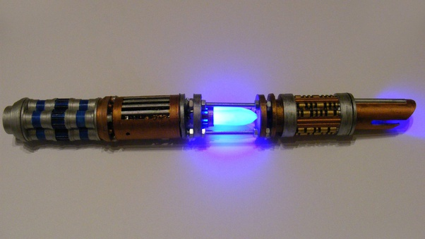
KYBER

Slide 5

Kyber IND-CPA PKE
KeyGen:
  A$\underset{←}{\$}R_{q}^{k×k}$, $s\underset{←}{χ}R_{q}^{k}$, $e\underset{←}{χ}R_{q}^{k}$.
  pk: $t=As+e$, sk: $s$.
Enc:
  $r\underset{←}{χ}R_{q}^{k}$, $e_{1}\underset{←}{χ}R_{q}^{k}$, $e_{2}\underset{←}{χ}R_{q}$.
  $c=(u,v)$, where $u=A^{⊤}r+e_{1}$, and $v=t^{⊤}r+e_{2}+m$.
Dec:
  $m=[v−s^{⊤}u]$, where $[⋅]$ denotes rounding (Compress).

Slide 6
KYBER IND-CCA2 KEM
Apply F-O Transform to KYBER-PKE.

Slide 7
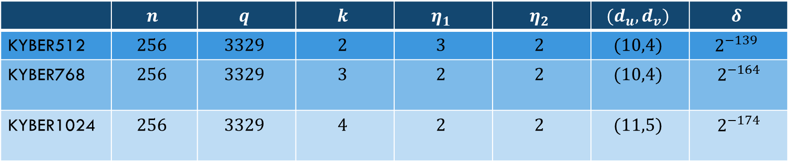
Kyber Parameter Sets
 | $$n$$ | $$q$$ | $$k$$ | $$η_{1}$$ | $$η_{2}$$ | $$(d_{u},d_{v})$$ | $$δ$$
KYBER512 | $$256$$ | $$3329$$ | $$2$$ | $$3$$ | $$2$$ | $$(10,4)$$ | $$2^{−139}$$
KYBER768 | $$256$$ | $$3329$$ | $$3$$ | $$2$$ | $$2$$ | $$(10,4)$$ | $$2^{−164}$$
KYBER1024 | $$256$$ | $$3329$$ | $$4$$ | $$2$$ | $$2$$ | $$(11,5)$$ | $$2^{−174}$$

Slide 8
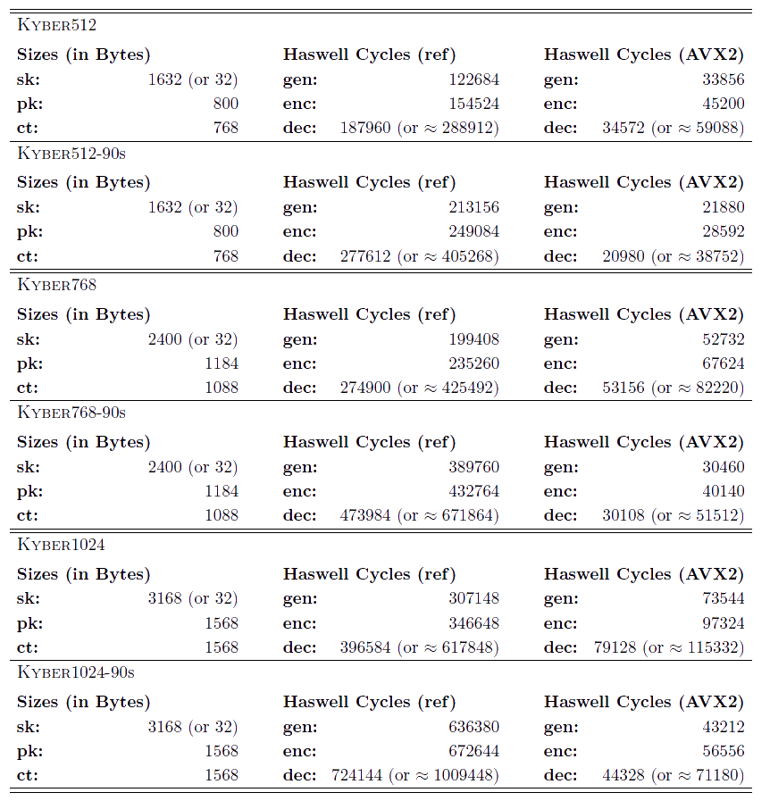
KYBER Performance

Slide 9
KYBER Security
Reduction from MLWE Assumption in ROM (tight)
Reduction from MLWE Assumption in QROM (non-tight)
Reduction from MLWE Assumption in QROM under non-standard assumption (tight): a deterministic CPAPKE is prseudo-random in QROM.
UPDATE: Discuss “beyond ‘core-SVP’ hardness” attacks and attacks using decryption failures
Classical core-SVP hardness (118, 182, 256) (actually uses an LWR assumption for these figures). A conservation estimate for Kyber512 because the total variance of each coefficient is greater then 3/2 which was used for the estimate.
Classical gate count estimates (151.5,215.1,287.3)

Slide 10
KYBER Changes From Round 2
Increased the noise parameter for KYBER512 to increase core-SVP hardness
Insignificantly changed ciphertext compression
Increased rejection rate in sampling with much faster sampling
  Key gen is faster
  Rejection rate is about 20%
Now say that core-SVP is a bad measure of security
  Added a “Beyond core-SVP hardness” section including a more careful gate-count estimate

Slide 11

Saber

Slide 12

SABER IND-CPA PKE
KeyGen:
  A$\underset{←}{\$}R_{q}^{l×l}$, $s\underset{←}{χ}R_{q}^{l}$.
  pk: $A,b={\left\lfloor A^{⊤}s+h\right\rfloor }_{p}∈R_{p}^{l}$ (shift to Zp) , sk: $s$.
Enc:
  $s′\underset{←}{χ}R_{q}^{l}$.
  $b^{′}={\left\lfloor As^{′}+h\right\rfloor }_{p}∈R_{p }^{l}$ (shift to Zp) , $s^{′}={\left\lfloor s^{′}\right\rfloor }_{p}∈R_{p}^{l}$
  $c={\left({⌊b}^{⊤}s^{′}+h_{1}+\frac{mp}{2}\right\rfloor }_{T},b′)∈R_{T}×R_{p}^{l}$. (shift to Z_{T})
Dec:
  $s={\left\lfloor s\right\rfloor }_{p}∈R_{p}^{l}$
  $m=\left[b^{′⊤}s−\frac{p}{T}c+h_{2}\right]p≫(p−1)∈R_{2}$ (shift (10-1) positions)

Slide 13
SABER IND-CCA2 KEM
Apply F-O Transform

Slide 14
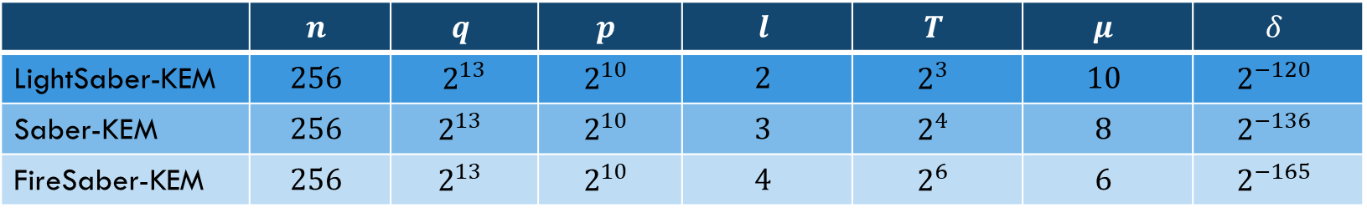
SABER Parameter Sets
 | $$n$$ | $$q$$ | $$p$$ | $$l$$ | $$T$$ | $$μ$$ | $$δ$$
LightSaber-KEM | $$256$$ | $2^{13}$ | $$2^{10}$$ | $$2$$ | $$2^{3}$$ | $$10$$ | $$2^{−120}$$
Saber-KEM | $$256$$ | $$2^{13}$$ | $$2^{10}$$ | $$3$$ | $$2^{4}$$ | $$8$$ | $$2^{−136}$$
FireSaber-KEM | $$256$$ | $$2^{13}$$ | $$2^{10}$$ | $$4$$ | $$2^{6}$$ | $$6$$ | $$2^{−165}$$

Slide 15
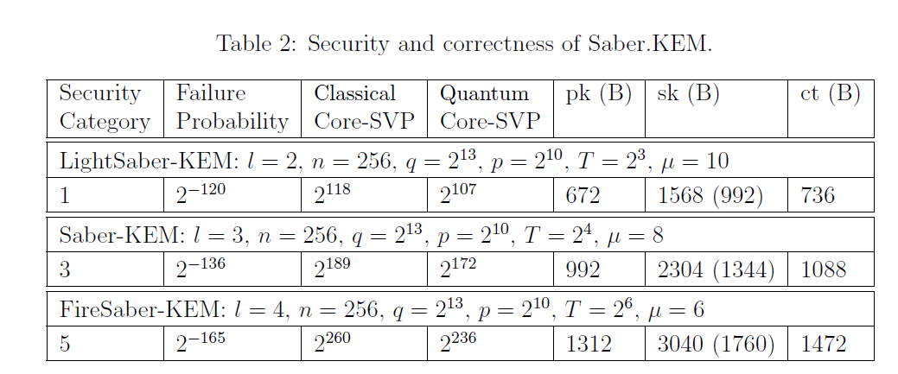
SABER Performance I

Slide 16
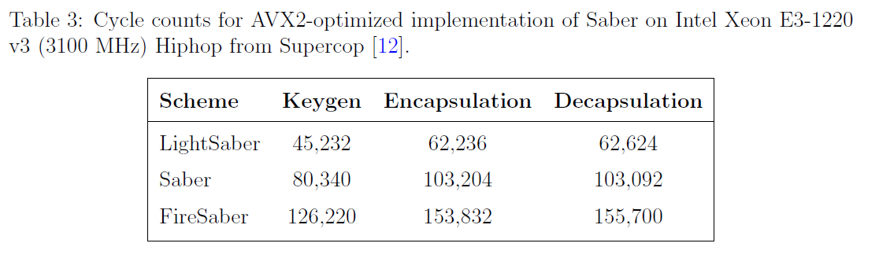
SABER Performance II

Slide 17
SABER Security
Reduction from MLWR Assumption in ROM
Reduction from MLWR Assumption in QROM
  OW-CPA implies IND-CPA. IND-CPA implies CCA KEM not tight: gap: a factor of square root of IND-CPA advantage.
  Said that the square root loss can be avoided.
  https://eprint.iacr.org/2021/454.pdf Corollary 4.7. PKE is “injective” (injectivity failure rate is η), the square root is gone. However, the gap has one more term: the PRF’s gap of the KDF which produces “implicit rejection” random key (negligible term) .

Slide 18
Saber Changes from Round 2
Corrected an error in security estimate script.
Streamlined the code
Include new parameter sets uSaber and Saber-90s.
Include a description of a masked implementation protecting against DPA
Include a section on side-channel security.
Some missing data type conversions were added to the spec.

Slide 19
KYBER and Saber Performance comparisons
Cycle counts on AVX2
SABER
KYBER
 | KYBER’s total cycle count | SABER’s total cycle count | Difference | Difference in %
L1 | 113,628 | 170,092 | 56,464 | 33.196
L3 | 173,512 | 286,636 | 113,124 | 39.466
L5 | 249,996 | 435,752 | 185,756 | 42.628

Slide 20
KYBER and Saber Performance comparisons
Public key and ciphertext sizes
 | Kyber (bytes) | Saber (bytes) | Difference | Difference in %
L1 | 1558 | 1408 | 150 | 9.627
L3 | 2272 | 2080 | 192 | 8.450
L5 | 3136 | 2784 | 352 | 11.224

Slide 21
KYBER and Saber Performance comparisons
Size Differences vs. Cycle Count Differences (on AVX2)
 | Kyber (bytes) | Saber (bytes) | Difference (bytes) | Difference in %
L1 | 1558 | 1408 | 150 | 9.627
L3 | 2272 | 2080 | 192 | 8.450
L5 | 3136 | 2784 | 352 | 11.224
 | KYBER’s total cycle count | SABER’s total cycle count | Difference(cycles) | Difference in %
L1 | 113,628 | 170,092 | 56,464 | 33.196
L3 | 173,512 | 286,636 | 113,124 | 39.466
L5 | 249,996 | 435,752 | 185,756 | 42.628

Slide 22
KYBER, Saber & NTRU Performance comparisons
Size Differences
 | Kyber (bytes) | Saber (bytes) | Difference (bytes) | Difference in %
L1 | 1558 | 1408 | 150 | 9.627
L3 | 2272 | 2080 | 192 | 8.450
L5 | 3136 | 2784 | 352 | 11.224
 | PK in bytes | Ciphertext in bytes | Total | Difference with lightSaber (bytes)
ntruhps509 | 699 | 699 | 1,398 | -10
ntruhrss701 | 1138 | 1138 | 2,276 | +868

Slide 23
KYBER, Saber & NTRU Performance comparisons cont.
Cycle Count Differences (on AVX2)
 | KYBER’s total cycle count | SABER’s total cycle count | Difference(cycles) | Difference in %
L1 | 113,628 | 170,092 | 56,464 | 33.196
L3 | 173,512 | 286,636 | 113,124 | 39.466
L5 | 249,996 | 435,752 | 185,756 | 42.628
ntruhps509 | 191,279 (k) | 61,331 (e) | 40,026 (d) | 292,636 (t)
ntruhrss701 | 340,823 | 50,441 | 62,267 | 453,531

Slide 24
 |  | Key (min) (cycles) | Enc (min)(cycles) | Dec (min)(cycles) | Total | Saber’s advantage
lightsaber | m4fspeed | 352,196 | 481,005 | 452,653 | 1,285,854 | 15.26%
lightsaber | m4fstack | 422,434 | 591,555 | 581,072
saber | m4fspeed | 645,221 | 820,798 | 774,054 | 2,240,073 | 9.52%
saber | m4fstack | 820,043 | 1,059,168 | 1,038,681
firesaber | m4fstack | 1,319,644 | 1,615,254 | 1,595,644
firesaber | m4fspeed | 994,445 | 1,204,257 | 1,151,014 | 3,349,716 | 12.86%
kyber512 | clean | 630,445 | 841,864 | 935,844
kyber512 | m4 | 456,044 | 550,598 | 510,889 | 1,517,531
kyber768 | clean | 1,049,570 | 1,347,982 | 1,462,338
kyber768 | m4 | 742,205 | 896,676 | 836,985 | 2,475,866
kyber1024 | clean | 1,635,186 | 2,008,239 | 2,146,442
kyber1024 | m4 | 1,185,257 | 1,368,598 | 1,290,241 | 3,844,096
Time-optimized Implementations for pqm4
https://github.com/mupq/pqm4/blob/master/benchmarks.md

Slide 25
 |  | Key (min) (cycles) | Enc (min)(cycles) | Dec (min)(cycles) | Total | Saber’s advantage
lightsaber | m4fspeed | 352,196 | 481,005 | 452,653 | 1,285,854 | 15.26%
ntruhps509 | m4f | 80,183,840 | 563,395 | 536,376 | 81,283,611
saber | m4fspeed | 645,221 | 820,798 | 774,054 | 2,240,073 | 9.52%
saber | m4fstack | 820,043 | 1,059,168 | 1,038,681
firesaber | m4fstack | 1,319,644 | 1,615,254 | 1,595,644
firesaber | m4fspeed | 994,445 | 1,204,257 | 1,151,014 | 3,349,716 | 12.86%
kyber512 | clean | 630,445 | 841,864 | 935,844
kyber512 | m4 | 456,044 | 550,598 | 510,889 | 1,517,531
kyber768 | clean | 1,049,570 | 1,347,982 | 1,462,338
kyber768 | m4 | 742,205 | 896,676 | 836,985 | 2,475,866
kyber1024 | clean | 1,635,186 | 2,008,239 | 2,146,442
kyber1024 | m4 | 1,185,257 | 1,368,598 | 1,290,241 | 3,844,096
Time-optimized Implementations for pqm4
https://github.com/mupq/pqm4/blob/master/benchmarks.md

Slide 26
 |  | Key (bytes) | Enc (bytes) | Dec (bytes) | Total (bytes) | Kyber’s advantage
lightsaber | m4fspeed | 5,612 | 6,284 | 6,292
lightsaber | m4fstack | 3,276 | 3,052 | 3,060 | 9,388
saber | m4fspeed | 6,644 | 7,316 | 7,324
saber | m4fstack | 3,788 | 3,180 | 3,188 | 10,156
firesaber | m4fstack | 4,300 | 3,316 | 3,324 | 10,940
firesaber | m4fspeed | 7,668 | 8,340 | 8,348
kyber512 | clean | 6,100 | 8,764 | 9,540
kyber512 | m4 (memory?) | 2,212 | 2,300 | 2,316 | 6,828 | 27.26%
kyber768 | clean | 10,196 | 13,364 | 14,460
kyber768 | m4 (memory?) | 3,092 | 2,772 | 2,796 | 8,660 | 14.73%
kyber1024 | clean | 15,076 | 2,772 | 2,796
kyber1024 | m4 (memory?) | 3,604 | 3,284 | 3,316 | 10,204 | 6.72%
Memory-optimized Implementations for pqm4
https://github.com/mupq/pqm4/blob/master/benchmarks.md

Slide 27
 |  | Key (bytes) | Enc (bytes) | Dec (bytes) | Total (bytes) | Kyber’s advantage
ntruhps509 | m4f | 21,400 | 14,068 | 14,800 | 50,268
lightsaber | m4fstack | 3,276 | 3,052 | 3,060 | 9,388
ntruhrss701 | m4f | 27,560 | 18,324 | 20,560 | 66,444
saber | m4fstack | 3,788 | 3,180 | 3,188 | 10,156
firesaber | m4fstack | 4,300 | 3,316 | 3,324 | 10,940
firesaber | m4fspeed | 7,668 | 8,340 | 8,348
kyber512 | clean | 6,100 | 8,764 | 9,540
kyber512 | m4 (memory?) | 2,212 | 2,300 | 2,316 | 6,828 | 27.26%
kyber768 | clean | 10,196 | 13,364 | 14,460
kyber768 | m4 (memory?) | 3,092 | 2,772 | 2,796 | 8,660 | 14.73%
kyber1024 | clean | 15,076 | 2,772 | 2,796
kyber1024 | m4 (memory?) | 3,604 | 3,284 | 3,316 | 10,204 | 6.72%
Memory-optimized Implementations for pqm4
https://github.com/mupq/pqm4/blob/master/benchmarks.md

